Slide 1
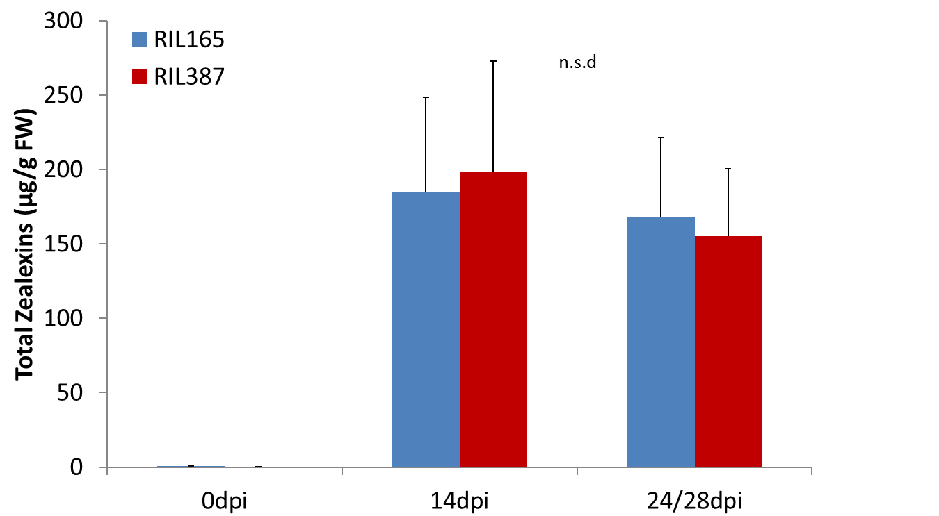
Additional file 8: Zealexin defences are induced in response to C. zeina.
Leaves were treated with a spore solution (3×10⁵ conidia/ml) and harvested at 0 days post inoculation (dpi), 14dpi and 24 or 28dpi (RIL165 and RIL387 respectively). The metabolite content of each sample was analysed using gas chromatography/chemical ionization – mass spectrometry. Zealexins were quantified based on the internal standard ¹³C₁₈-linolenic acid and presented in µg/g FW. Average levels of total zealexin metabolites depicted for RIL165 and RIL387 (n =3-5; ±SEM).

